Slide 1
What is circleci and benefits of circleci

Slide 2
CircleCI in your workflow
A software repository on a supported version control system needs to be authorized and added as a project on circleci.com. Every code change then triggers automated tests in a clean container or virtual machine. CircleCI runs each job in a separate container or virtual machine.
CircleCI then sends an email notification of success or failure after the tests complete. CircleCI also includes integrated Slack and IRC notifications. Code test coverage results are available from the details page for any project for which a reporting library is added.
CircleCI may be configured to deploy code to various environments, including:
AWS CodeDeploy
AWS EC2 Container Service (ECS)
AWS S3, Google Kubernetes Engine (GKE)
Microsoft Azure
Heroku
The orbs registry contains packages of reusable configuration that can be used for common deployment targets. Orbs simplify and streamline your configuration.
Other cloud service deployments can be scripted using SSH, or by installing the API client of the service with your job configuration.

Slide 3
Benefits of CircleCI
CircleCI runs nearly one million jobs per day in support of 30,000 organizations. Organizations choose CircleCI because jobs run fast and builds can be optimized for speed.
CircleCI can be configured to run very complex pipelines efficiently with sophisticated caching, docker layer caching, and resource classes for running on faster machines.
As a developer using CircleCI you can:
SSH into any job to debug your build issues.
Set up parallelism in your .circleci/config.yml file to run jobs faster.
Configure caching with two simple keys to reuse data from previous jobs in your workflow.
Configure self-hosted runners for unique platform support.
Access Arm resources for the machine executor.
Use orbs, reusable packages of configuration, to integrate with third parties.
Use pre-built Docker images in a variety of languages.
Use the API to retrieve information about jobs and workflows.
Use the CLI to access advanced tools locally.
Get flaky test detection with test insights.
As an operator or administrator of CircleCI installed on your own servers, CircleCI provides monitoring and insights into your builds and uses Nomad for scheduling

Slide 4
Features of CircleCI
Quick and easy setup.
Allows tailored customization.
Beginner-friendly for CI/CD.
Allocates parallel processes for faster deployment.
Internal dedicated server not required.
Pros of CircleCI
Offers comprehensively flexible pricing options with broad scope for scaling.
Allows developers to debug in the build using SSH.
After successfully uploading the application repository from Github to CircleCI, each code update triggers automated test execution in a new separate container.
Parallel builds are possible too, for rapid implementation of multiple tasks.
Once a task is executed, developers get quick notifications and results via email.
Allows Slack integration for a seamless collaboration experience

Slide 5
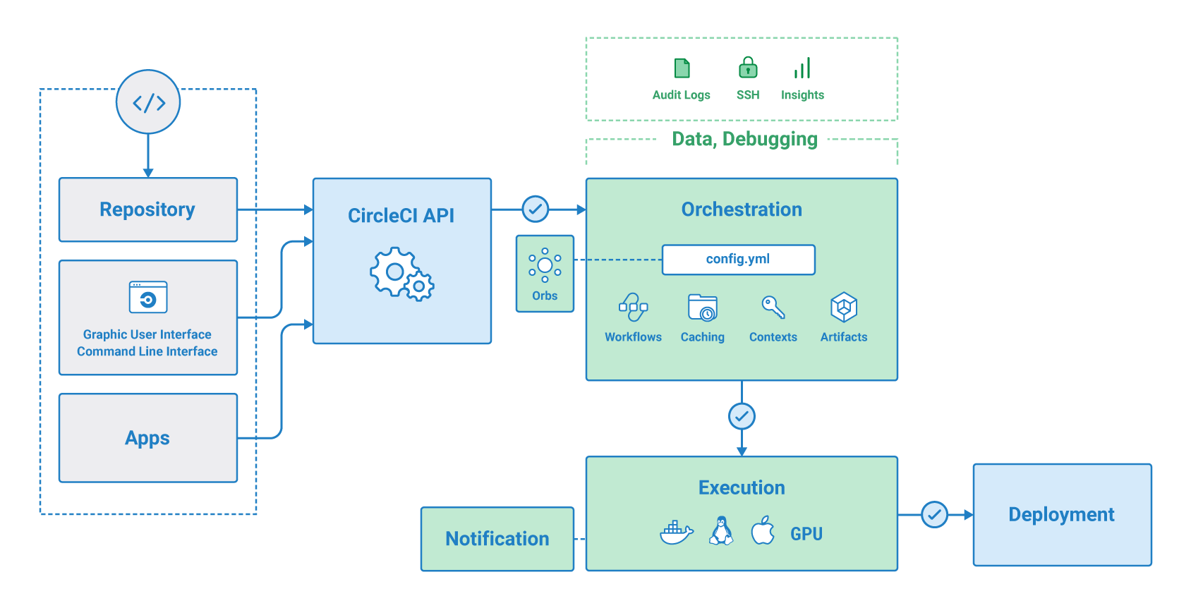

Slide 6
Key Differences Between Jenkins and CircleCI
Both Jenkins vs CircleCI are popular choices in the market; let us discuss some of the major Difference Between Jenkins and CircleCI:
Jenkins can support multiple jobs by multi-threading, whereas CircleCI has built support for parallelism, which project settings can achieve.
In Jenkins, builds are configured using web UI with settings stored in the Jenkins server, whereas, in CircleCI, jobs can be built using the “circle.yaml” file.
CircleCI has the best feature for debugging, “Debug via SSH”, which makes debugging easier, whereas Jenkins, we need to debug by clicking on Jobs manually.
CircleCI changes the environment without warning, which is an issue, whereas it will change only when the user instructs in Jenkins.
In Jenkins, we can cache Docker images using a private server, whereas, in CircleCI, we can’t cache the Docker images.
In Jenkins, secrets will be encrypted using Jenkins credentials and Plugin, whereas, in CircleCI, we don’t have security like Jenkins.

Slide 7
Jenkins and CircleCI Comparison Table
The Basis of Comparison | Jenkins | CircleCI
Build Configuration | In Jenkins, Builds are configured using Jenkins UI, and all settings of the jobs are stored on the Jenkins file system in the Jenkins server, which makes it difficult to share configuration details with the team or organization. By cloning Github or other source repositories can’t copy info stored in Jenkins. | In CircleCI, we can build all jobs within a single file called “circle.yaml”. It is easy as CI configuration will be like any other source code repos, which make it easy to share and backup. On CircleCI, only a few settings like secrets will be stored in an encrypted format.
Build Machines Access | In Jenkins, the DevOps person or team need to maintain the Jenkins server by installing all dependencies and debug if any issues are there. Debugging will be a little bit difficult in Jenkins. | In CircleCI, we don’t need to maintain the server as every job will be started in a new environment where all the dependencies will be installed by default. Troubleshooting in it will be easy due to its ssh feature. DevOps team can do whatever they need on host os without effecting builds where developers can debug using its ssh feature.
Web UI | Jenkins web UI was originally developed in a different landscape of web technology which is still fairly dated. In it, every page load will need to render completely by the server, which makes the navigation experience a little slow and clumsy process. Web UI becomes slow or less responsive due to more number of plugins. | In CircleCI, Web UI is a single page web application that is developed using AJAX, HTML5 and new technologies to make the user experience fast and easy to use. CircleCI web UI will be changed frequently with improvements which makes it popular among users.
Plugins | In Jenkins, Plugins plays an important role as we will be using plugins for most of the tasks, such as if we want to check out the Git repo, we need the GitHub plugin. These plugins are developed in Java which can be integrated with a number of plugins which generates web view in JSP pages. | In CircleCI, almost all core functionality is built-in, like checking out the source code from GitHub or Bitbucket, running jobs, storing artifacts, and parsing the output without any plugins. We can develop shell scripts to add any functionality as we required.
Containers and Docker | In Jenkins, we don’t have built-in support for Docker workflow; the user needs to install and make it available in the built environment. | In CircleCI, we have built-in support for Docker in the workflow, which can be accessed by adding in the services section in the “circle.yaml” file.
Parallelism | In Jenkins, we can run multiple jobs or tests at a time using multi-threading, but it may cause issues related to database and file systems which will be difficult to debug. | In CircleCI, It has the inbuilt facility to support parallelism, which can be done by changing project settings- using multiple containers at once.
Environment Change | In Jenkins, the environment will change with user permission and gives a warning if it changes. | In CircleCI, the environment will change without any warning, which leads to debugging more number of days.

Slide 8
Using the shell
CircleCI provides an on-demand shell to run commands. In this first example, you will set up a build and execute a shell command.
If you have not done so already, sign up with CircleCI and select your Version Control System (VCS). You can also sign up with email.
Create a .circleci folder at the root of your project. Make sure the folder starts with a period so that CircleCI can identify it.
Create a config.yml file inside the .circleci folder and paste the following code:
version: 2.1
jobs:
build:
docker:
- image: alpine:3.15
steps:
- run:
name: The First Step
command: |
echo 'Hello World!'
echo 'This is the delivery pipeline'

Slide 9
The following commentary describes what occurs in each line of the sample code:
Line 1: This indicates the version of the CircleCI platform you are using. 2.1 is the most recent version.
Line 2: The jobs level contains a collection of children, representing your jobs. You specify the names for these jobs, for example, build, test, deploy.
Line 3: build is the first child in the jobs collection. In this example, build is also the only job.
Line 4: This specifies that you are using a Docker image for the container where your job’s commands are run.
Line 5: This is the Docker image. The example shows alpine:3.15, a minimal image based on Alpine Linux.
Line 6: The steps collection is a list of run directives.
Line 7: Each run directive is executed in the order in which it is declared.
Line 8: The name attribute provides useful information when returning warnings, errors, and output. The name should be meaningful to you as an action within your build process.
Line 9: The command attribute is a list of shell commands that you want to execute. The initial pipe, |, indicates there will be multiple lines of shell commands.
Line 10: Prints Hello World! in your build shell.
Line 11: Prints This is the delivery pipeline.
Commit your config.yml file (and push, if you are working remotely).
On the Projects page in CircleCI, find your project and click the blue Set Up Project button next to it.

Slide 10
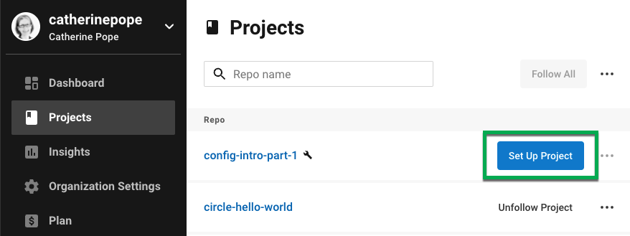
In the pop-up window, choose the default Fastest option for selecting your config.yml file. Then type the name of the branch on which you committed it. If you followed steps 2 and 3, you will see a green tick to confirm that CircleCI has located a config.yml file in the .circleci directory of your project. Now click the blue Set Up Project button.

Slide 11
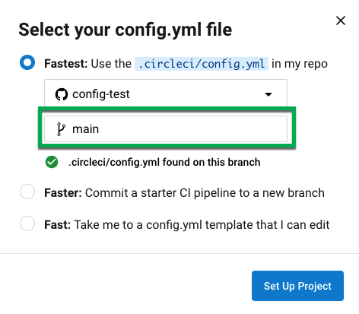
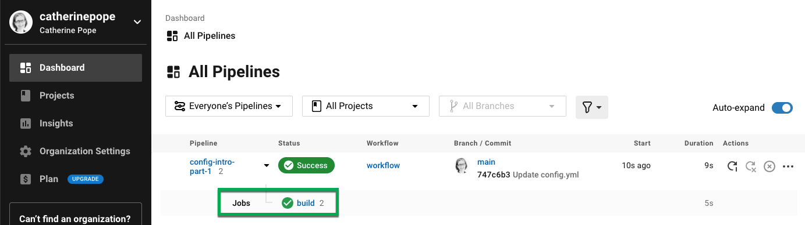
CircleCI uses your config.yml file to run the pipeline. You can see the output in the CircleCI dashboard. A green tick denotes a successful pipeline. A red exclamation mark alerts you to a failure. Click on the job for more details.

Slide 12
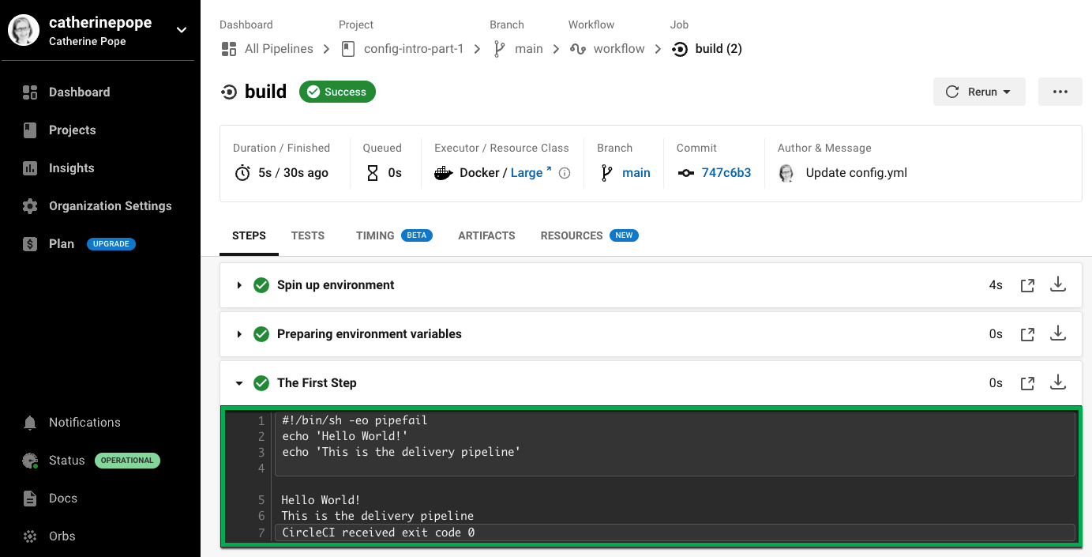
You should see your step - The First Step - with the the output of the commands:

Slide 13
Part 2: Using code from your repo
CircleCI provides several commands to simplify complex actions. In this example, you will use the checkout command. This command fetches the code from your git repo. Once you have retrieved that code, you can work with it in subsequent steps.
If you have not done so already, create a .circleci directory in your project, add a config.yml file, and type or paste the code from the example below.
If you already have a config.yml file from the example above, here are the changes you need to make:
On Line 5, change the image to cimg/base:2021.04.
On Line 7, add a checkout command.
Add another run step (lines 13-17) at the end.
Make sure you observe the indentation.

Slide 14
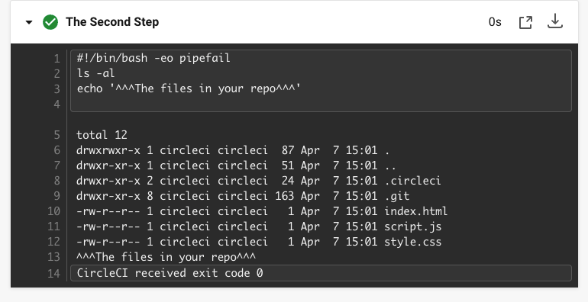
version: 2.1
jobs:
build:
docker:
- image: cimg/base:2021.04
steps:
- checkout
- run:
name: The First Step
command: |
echo 'Hello World!'
echo 'This is the delivery pipeline'
- run:
name: The Second Step
command: |
ls -al
echo '^^^The files in your repo^^^'
These two small changes have significantly increased the functionality of your config file:
Line 5: This line now specifies a Docker image that supports git. cimg/base:2021.04 is a small Ubuntu-based image for running basic jobs.
Line 7: The checkout command fetches the code from your git repo.
Lines 13-17: This second step in the build job is listing (using ls -al) the contents of the repo that has been checked out. You can now perform further actions on this repo.
As before, commit and push your updated config.yml file.
You should now see some additional steps on the CircleCI dashboard:
Checkout code has cloned the code from your git repository.
The Second Step has listed the files found in your git repository.

Slide 15
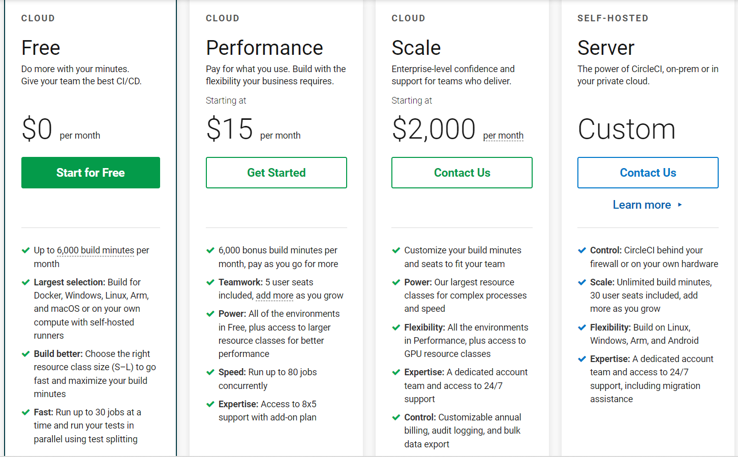

Slide 16
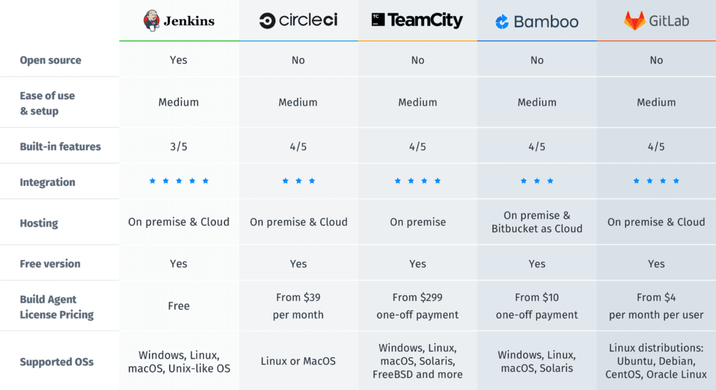

Slide 17
Conclusion
In conclusion, the key difference between CircleCI vs Jenkins is that Jenkins is more secure and elaborates; CircleCI is lightweight and open. Therefore for faster deployment jobs, one can execute their codes on CircleCI as it deploys on scalable and robust cloud servers
Jenkins follows groovy scripts and circleci follows yaml scripts which is easier than groovy we only need to check the indentations right

